Slide 1

ExlTech Solutions
Excel without Compromise

Slide 2


About Us
About Us
ExlTech 100% Subsidiary of USIT(Universal Steel Information Technology), is emerging as one of the leading specialist IT Training & Placement firm with a focus on providing High Quality Job Oriented Trainings, Our courses are taught by industry experts. We empower you with practical knowledge through our courses. With us, you get the intensive experience that will expose you to new challenges, and innovative ideas to perform better in your career.
Talent Management, Campus Recruitment and Contract Staffing services to individuals & IT organizations. We are committed to offering people related services with a view to enhance human talent in the organizations and hence resulting in overall organizational growth at large. ExlTtech conduct Campus to Corporate, an in-house training to increase the employability of students. We create lasting relationships with our clients by providing them with the best talent who will consistently deliver value.
Our organization has gained the reputation as a successful training and placement firm. We are involved in the various technical and non technical trainings and placement services in the information technology sector. We help organizations find the best employees as per the profile requirement to fit in the organizational culture.
Note :- We do not charge from the recruiter company. We try to give the best and trained candidate to the recruiter for the required job position.

Slide 3




What We Do?
ExlTech Solution is top most training firm for IT training and placements in Pune which provides 100% job guarantee. It is a best choice for the candidates who are willing to be a part of these ever-changing technology revolutions. We are committed to provide quality training to the candidates to enhance their career with latest technology and Knowledge.
Training
Live Projects
Soft Skills
Placement

Slide 4

Mission
Vision
To lead our training services worldwide in
developing and promoting standards, technologies
and educational services.
To empower organizations in the management of
effective trainings.
“Success of any training program depends on the quality of Trainer, Training Environment and Course Customization.
ExlTech has made a conscious effort to offer the best service possible, encompassing the above three deciding factors.”
Goals
Values
Ensure program excellence
Maintain and upgrade quality training.
Create Quality software professionals.
Promote, support& leverage Technology resources.
Commitment
Ethics
Excellence
Accountability
Teamwork
Integrity
Quality

Slide 5
Our Services :- IT Training
Technical Highlights :-
Technical training in Java course and .NET course includes following common terms
C, C++, SQL, PL-SQL, My-SQL, DS, UNIX . Apart from these the detailed Java Certification and .NET Certification course includes :
Java Certification Course :-
Core Java
Advance Java
J2EE
JSS, CSS
Frame Work
Struts
Hibernate
Springs
.NET Certification Course :-
C#
Framework
Windows
WPF
WCF
ASP.NET
VB.NET
MVC
Software Testing Course :-
C Brush up
SDLC
Manual Testing with practical
Selenium IDE, Web driver
QTP

Slide 6
Our Services :- Digital Marketing
Technical Highlights :-
ExlTech digital marketing program curriculum focuses on learning and applying digital strategies and solving
the real time business challenges.
Search Engine Optimization :-
Keyword Research
How Google works
Search engine factors
On-page Optimization
Off-page optimization
Meta tags, Images, Contents
Link building
Search engine marketing :-
Ad Words certification
How to create PPC campaign
Implementing your PPC budget
Managing Measuring and
optimizing campaign
Web Analytics :-
What is Web Analytics
Web Analytics Jargon
Web Analytics Implementation and
Configuration
Goal and Event Tracking
Social Media Optimization :-
What is Social Media Marketing
Increasing Traffic using link
Overview- Facebook, Twitter,
LinkedIn

Slide 7
Our Services :- Mechanical Design
Technical Highlights :-
The CAE/CAD training program presented is a Customized-Advance training which will definitely helps you to upgrade your profile with rapidly growing and outsourcing career opportunities. Following are the key contents of our training program
Basic mechanical Engineering
Engineering drawings and
Symbols
SOM, TOM, GD&T, Tolerance
& Fits
AutoCAD
Pro-E
CATIA
Solid works
Hyper mesh
(As per Company Requirement)
ANSYS (As per Company Requirement)
Product Designing
Aptitude
Soft skill
Project Work
German Language

Slide 8
Our Services :- Clinical Research
Technical Highlights :-
Training provided by ExlTech follows industry guidance and guidelines of : -
IPC
ICMR
PCI
W.H.O
ICH-GCP, GMP, GLP
CDSCO
PVPI
USFDA
MHFW
Apart from this the technical part of the course involves following concepts : -
Advanced Pharmaceutical Science
Pharmacovigillence
Clinical Research
Clinical Data Management
Drug Regulatory Affairs
Medical Writing and Summarizing
The training program presented is a Customized-Advance training . Following are the key contents of our training program :-
Live Projects and Case Studies
Group Discussion
Soft Skills
Aptitude & Communication
Personality Development
Corporate Email Etiquettes
Interview Skills
Guaranteed Placements
Advance Excel

Slide 9
Our Services :- Civil Engineering
Technical Highlights :-
The Civil engineering training program presented is a Customized-Advance training which will definitely helps you to upgrade your profile with rapidly growing and outsourcing career opportunities. Following are the key contents of our training program
Basic Civil Engineering
Revit Architecture
AutoCAD (Civil)
E-Tabs
Staad Pro
3DS max
SAFE
Google sketch up
Advance Civil engineering
Aptitude
Soft skill
Project Work
German Language

Slide 10
Our Services :- Electrical & Electronics Design
Technical Highlights :-
The Electrical & Electronic Design training program presented is a Customized-Advance training which will definitely helps you to upgrade your profile with rapidly growing and outsourcing career opportunities. Following are the key contents of our training program
Basic Electrical, Electronic and Instrumentation Engineering
PLC
SCADA
HMI
Drive
Electrical CAD & EPLAN
Wire Harness with CATIA v5
Robot programming
Lab View
Aptitude
Soft skill
Project Work
German Language

Slide 11

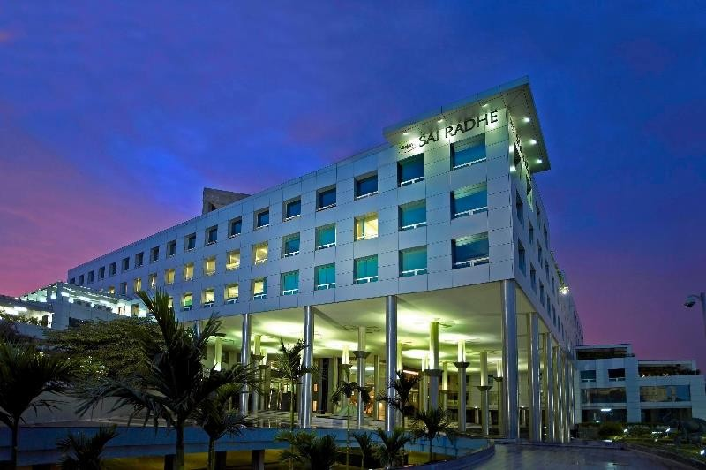
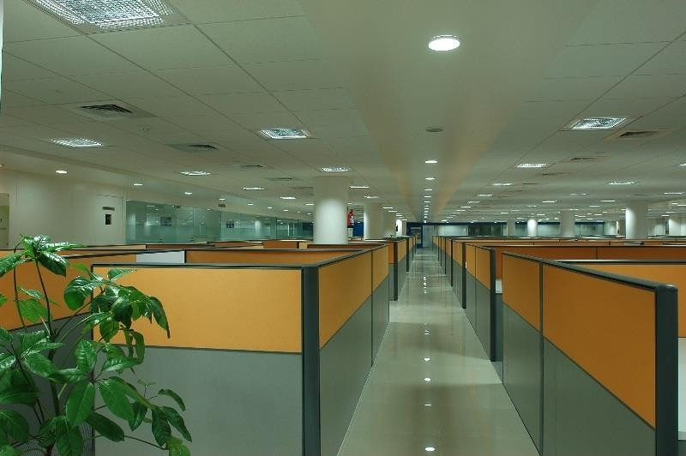
Training Facilities :-
96 nos. computer lab
24 Trainers
14 large Classrooms
Location :-
Prime location in the heart of the
city
Office in premium business center
Public transport easily available
.
Conference Room :-
50000 Sq ft. office area
6 Large conference rooms
22 personal interaction rooms
.
Project Title
First: What is a Fast-Fish? Alive or dead a fish is technically fast, when it is connected with an occupied ship or boat, by any medium at all controllable by the occupant or occupants,—a mast, an oar, a nine-inch cable, a telegraph wire, or a strand of cobweb, it is all the same.

Slide 12

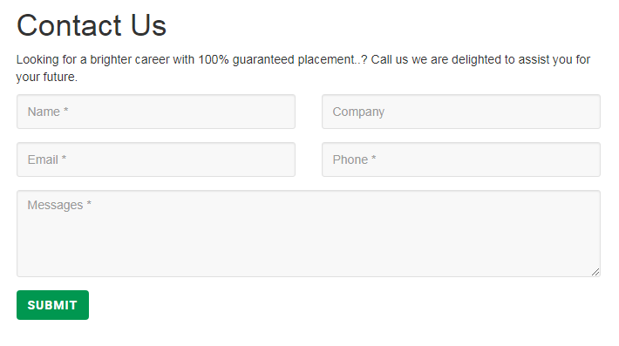
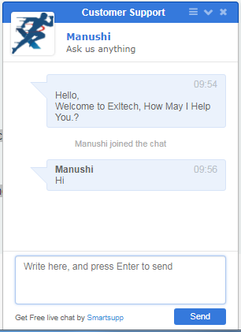
Helpdesk Included :-
Web Chat Help
Phone calls
Personal Interaction

Slide 13
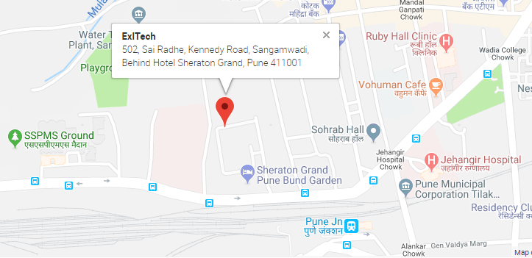
Get in Touch
With Us
ExlTech Solutions,
502, Sai Radhe, Kennedy Road, Behind Hotel Sheraton Grand, Near Pune Station, Pune 411 001,
Maharashtra, India
Phone: +91 9890549749
Email : qudrat.shaikh@exltech.in

